Slide 1
Docker Getting Started
02 Jan, 2026

Slide 2
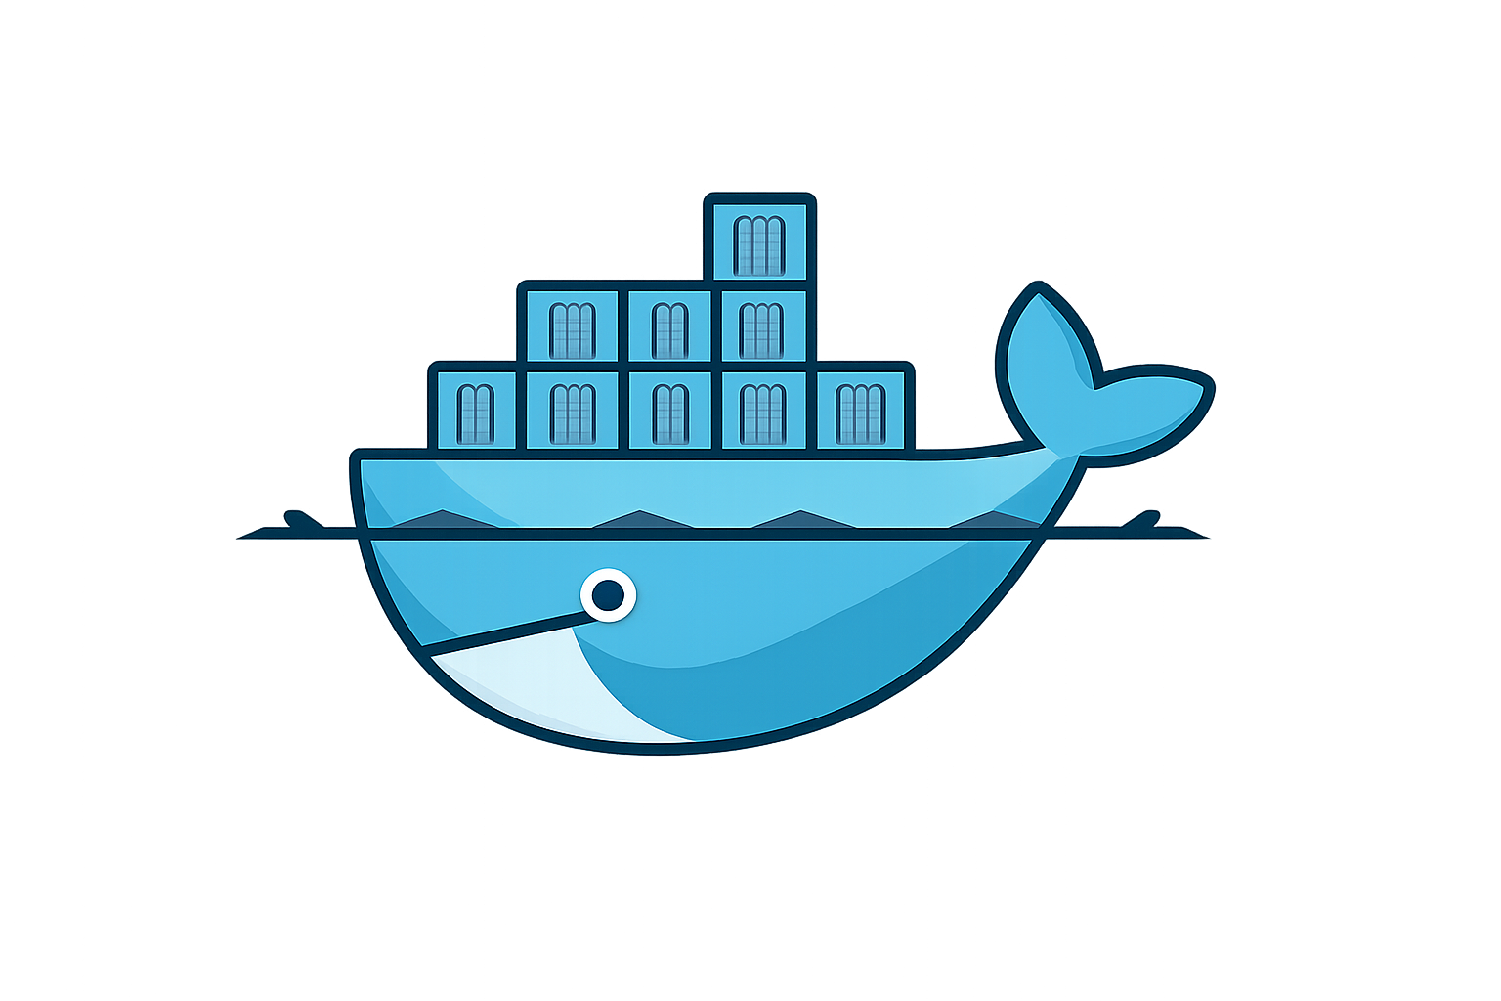
Overview
The Docker platform
Docker architecture
Develope containers
Build and push to registry
Docker basic concepts
Building Image
Running Containers
PHP Docker Workshop
  Mail Panel Application
  PHP Docker Sample
  File Manager
  Phonebook
  Wordpress
  Laravel Application
Javascript Workshop
  Time Calculator
  Rock Paper Scissor Game

Slide 3
What is Docker platform
Docker has methodology for developing, shipping, running, testing, deploying and delivery app. In the other hand streamlines the development lifecycle.
Separate your applications from your infrastructure (manage infrastructure)
Package your app in secure/isolate environment named container.
Containers is everything needed for application.
Run many containers simultaneously on machine. Share it while working (local) or on production as orchestrated service.

Slide 4

What is Docker platform
Docker's portability :
  Developers laptop
  Physical or virtual host machine on data center
  Cloud provider
  Mixture of above
Fast, consistent delivery.
Workloads: application process consuming resources (CPU, memory, disk I/O, network)
Continuous Integration and Continuous Delivery (CI/CD) workflows senario.
Docker provides a viable, cost-effective alternative to hypervisor-based virtual machines.

Slide 5
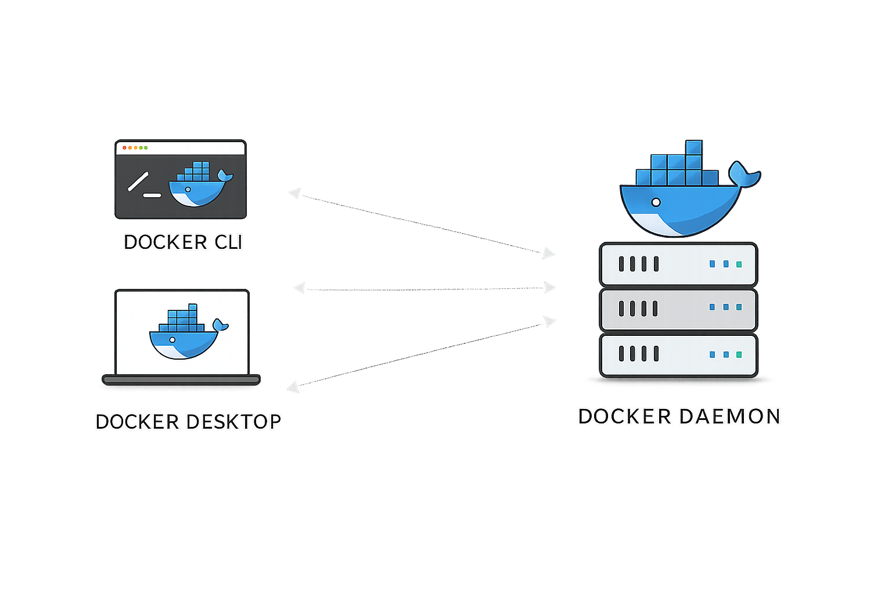
Docker Architecture
Client Server architecture
Docker uses a client-server architecture
  Docker Client
  Docker Daemon or dockerd

Slide 6
Docker client (docker)
Docker client can be either of
  Docker CLI
  Docker Desktop
  Docker Compose
Primary way to interact with dockerd
Docker client commands carried out by dockerd
Docker client can communicate with one or more daemon remote or on same system
Docker client and daemon are communicate using REST Api, Unix sockets and network interface

Slide 7
The Docker daemon (dockerd)
Daemon in Computing
Background process which perform tasks without any direct interaction with user
  Web Server daemon (Apache): listen for http request
  Database daemon (MySQL): listen for queries
  Cron daemon: run scheduled tasks in backgrounds
Docker Daemon
Long running process or service that running in background which listening for client
Docker daemon does heavy lifting tasks such as building , running and distributing containers

Slide 8
Docker Architecture
Docker Desktop
Docker Desktop includes the Docker daemon (dockerd), the Docker client (docker), Docker Compose, Kubernetes
Docker Registry
Store docker images
Docker hub is public and default docker registry
Private or custom registry
When you use the docker run , docker pull, docker push

Slide 9
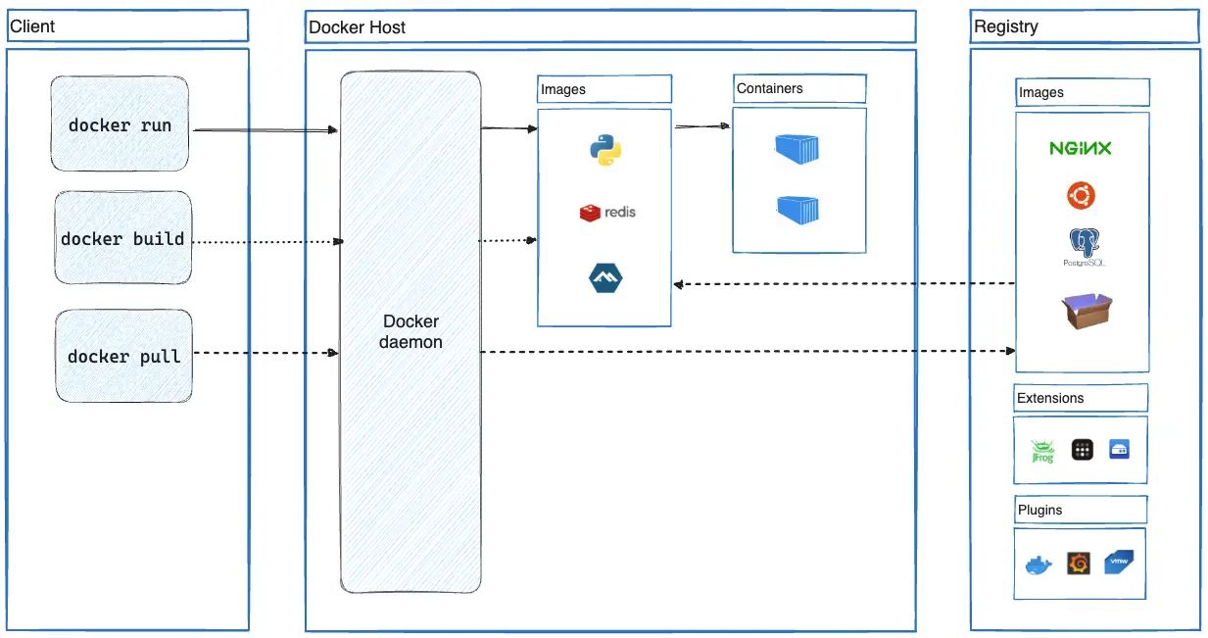

Slide 10
Docker Objects (Image)
Image is a readonly template file with instructions for creating container.
Each instruction is an image layer.
You may create your own image or using from other images from any registry or .Dockerfile
Images is an image from another image with some additional customization.
When you change the Dockerfile and rebuild the image, only those layers which have changed are rebuilt.

Slide 11
Docker Objects (Container)
A container is a runnable instance of an image (create from image).
Docker container has lifecycle from create to start and can stop or paused and finally delete.
Docker container can has one or more network or attach storage to it (data persistence after deletion).
Docker current state.
Create new image based on current state of container.
Container is defined by its image as well as any configuration options you provide to it when you create or start it:
  Identity & Lifecycle: name, restart policy, detach, interactive
  Networking: port mapping
  Environments
  Storage: volumes

Slide 12
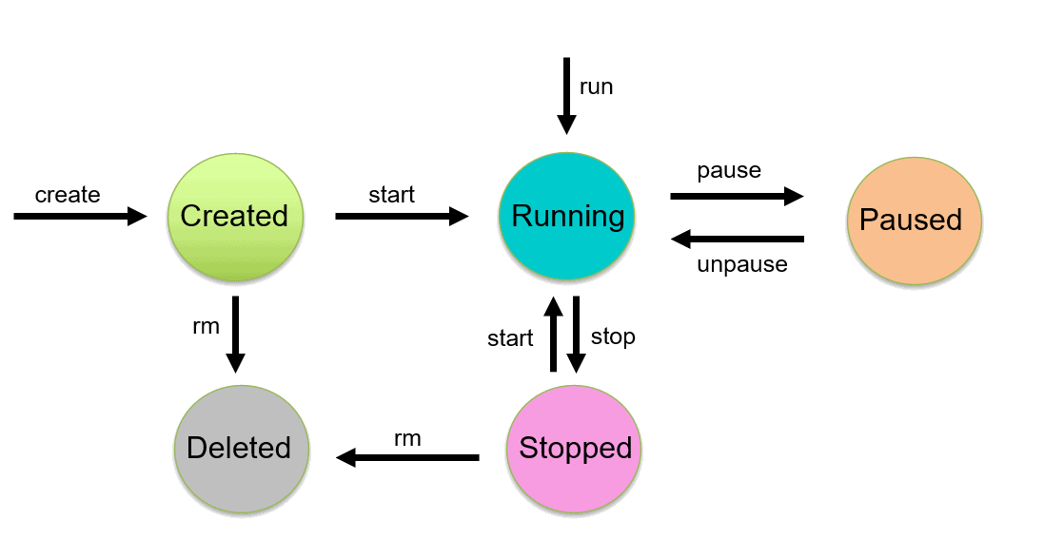
docker container run
docker container create
Docker container lifecycle state machine diagram

Slide 13
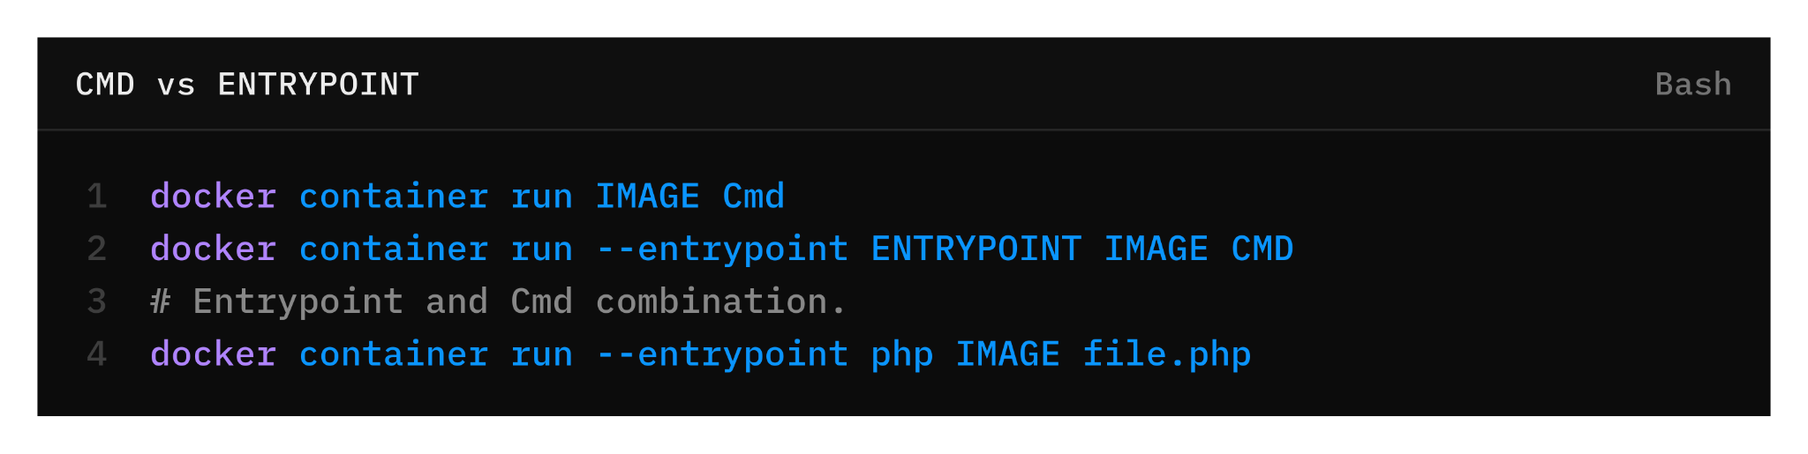
Cmd VS Entrypoint
Define what runs when a container starts.
They serve different purposes:
  ENTRYPOINT: what the container is. i.e. in mysql image docker-entrypoint.sh command as entrypoint.
  CMD: what the container does by default. i.e. ubuntu run /bin/bash as default command.
Behave differently when overridden.

Slide 14
Std in/out/err
Stdin: standard input
Stdout: standard output
Stderr: standard error
Standard output: Command > or Command 1>
Standard error: Command 2>
AttachStdin: false -i (true)
AttachStdout: true -d (false)
AttachStderr: true

Slide 15
TTY = Teletypewriter
Old school machines concept about terminal where you typed and the compute typed back.
Linux kept the name
Modern TTY Features
Line editing
Colors
Cursor movement
Ctrl + C, Ctrl + Z, and etc.

Slide 16
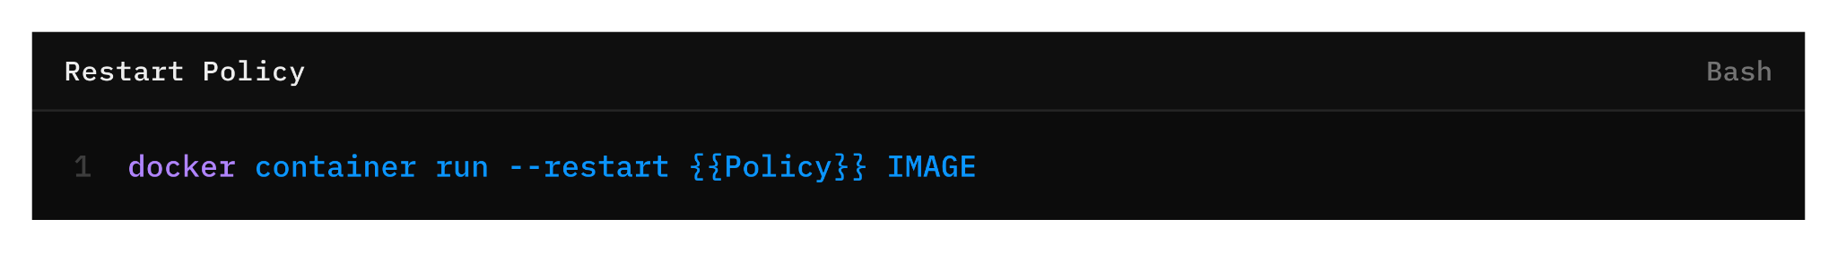
Restart Policy
 | Restart Host/Docker | Exit(zero code) | Exit(none-zero code) | Stop
always | ✔️ | ✔️ | ✔️ | ✔️
unless-stopped | ✔️ | ✔️ | ✔️ | ❌
on-failure | ✔️ | ❌ | ✔️ | ❌
no | ❌ | ❌ | ❌ | ❌

Slide 17
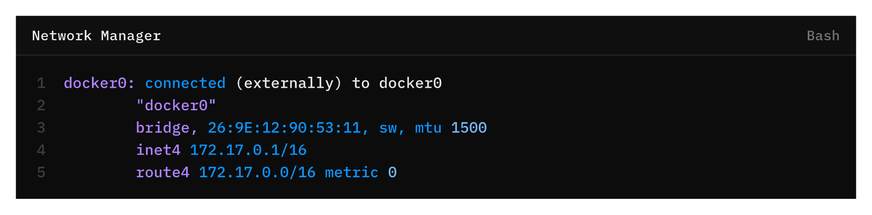
Docker Network
Ability for containers to connect with each other, and with non-Docker network services.
container sees a network interface with an IP address, a gateway, a routing table, DNS services, and other networking details.
Containers attached to the default bridge have access to network services outside the Docker host. They use "masquerading"

Slide 18
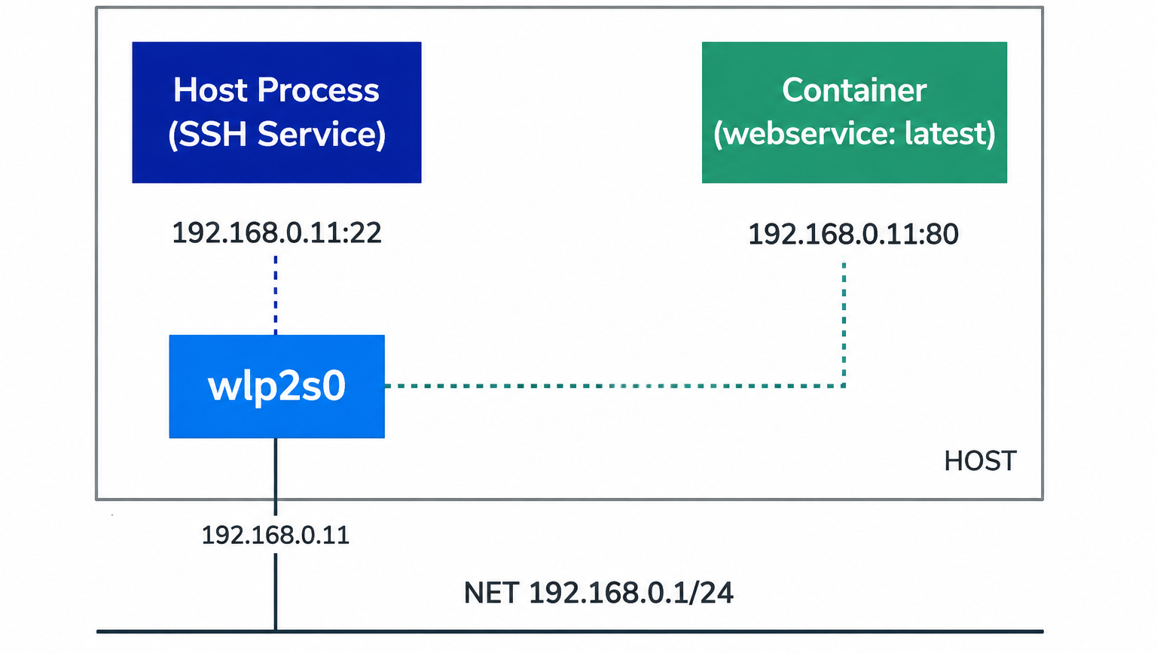

Slide 19
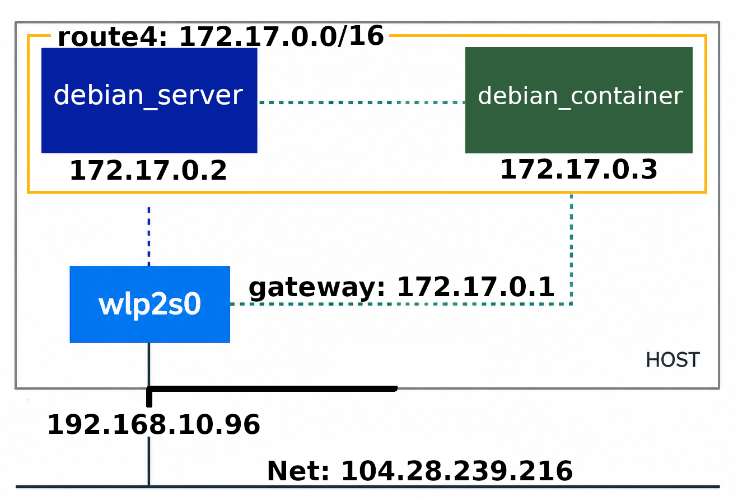

Slide 20
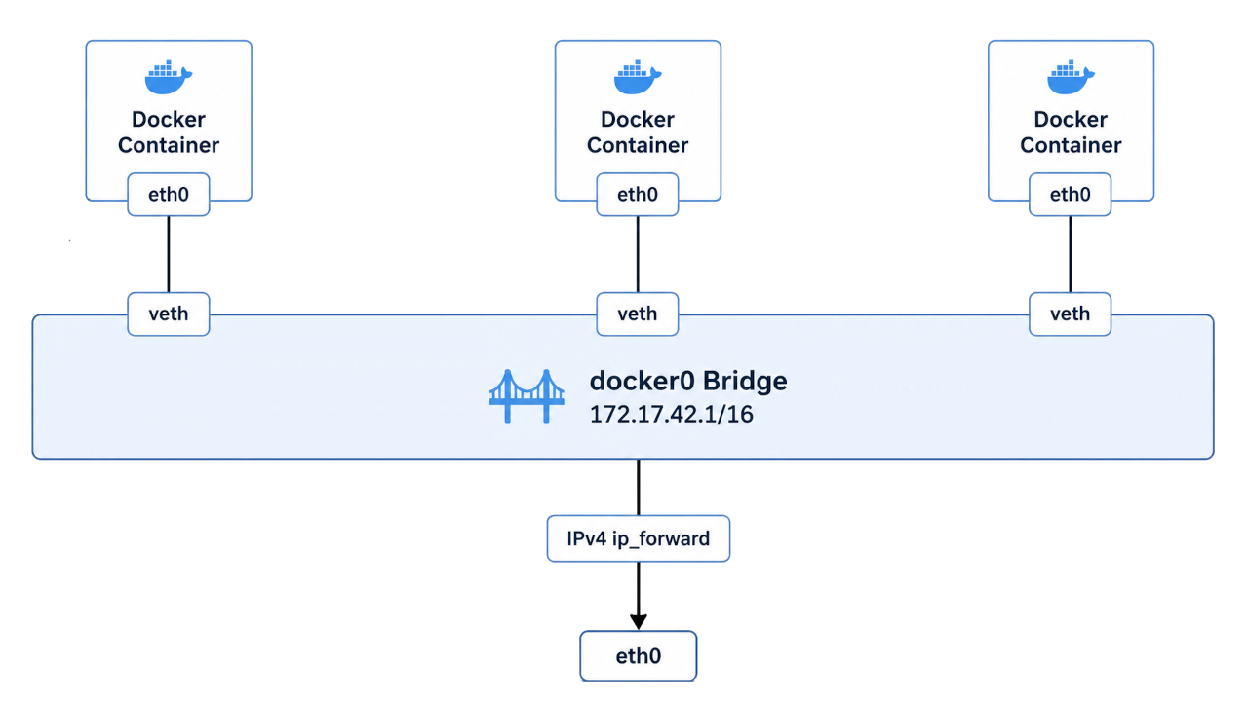

Slide 21
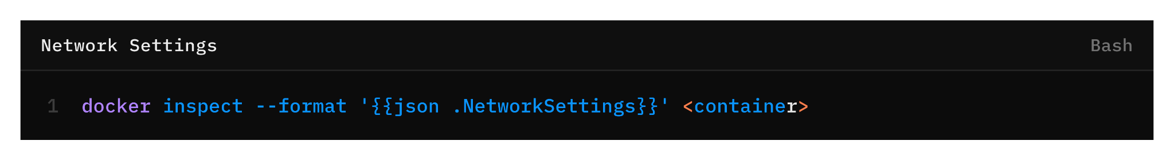
Default Network
When Docker Engine on Linux starts for the first time, it has a single built-in network called the "default bridge" network.
When you run a container without the --network option, it is connected to the default bridge.
With the default bridge network containers have unrestricted network access to each other using container IP addresses.
Connecting a container to a network can be compared to connecting an Ethernet cable to a physical host.

Slide 22
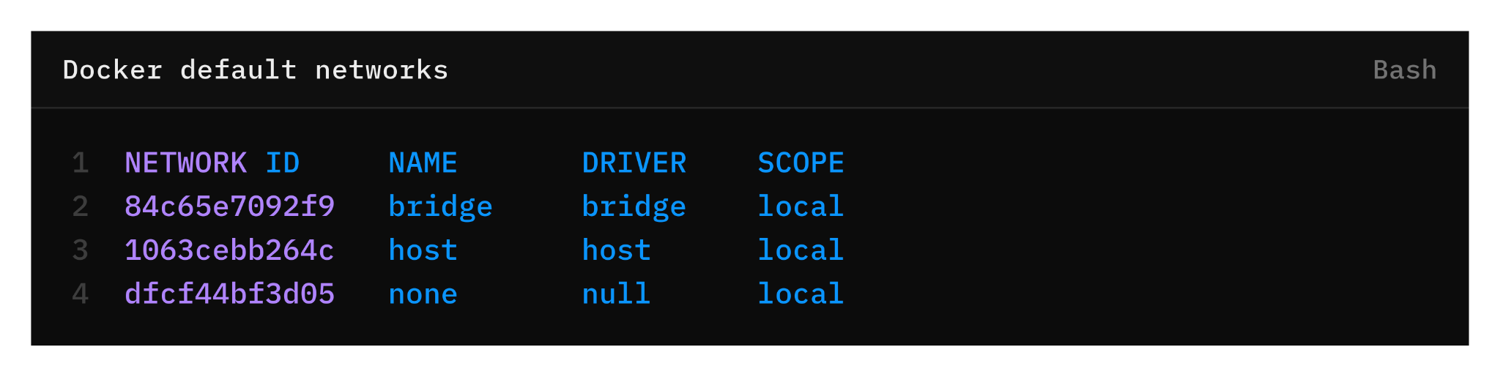
Network Drivers
Docker Engine has a number of network drivers, as well as the default "bridge".
  Bridge: The default network driver.
  Host: Remove network isolation between the container and the Docker host.
  None: Completely isolate a container from the host and other containers.

Slide 23
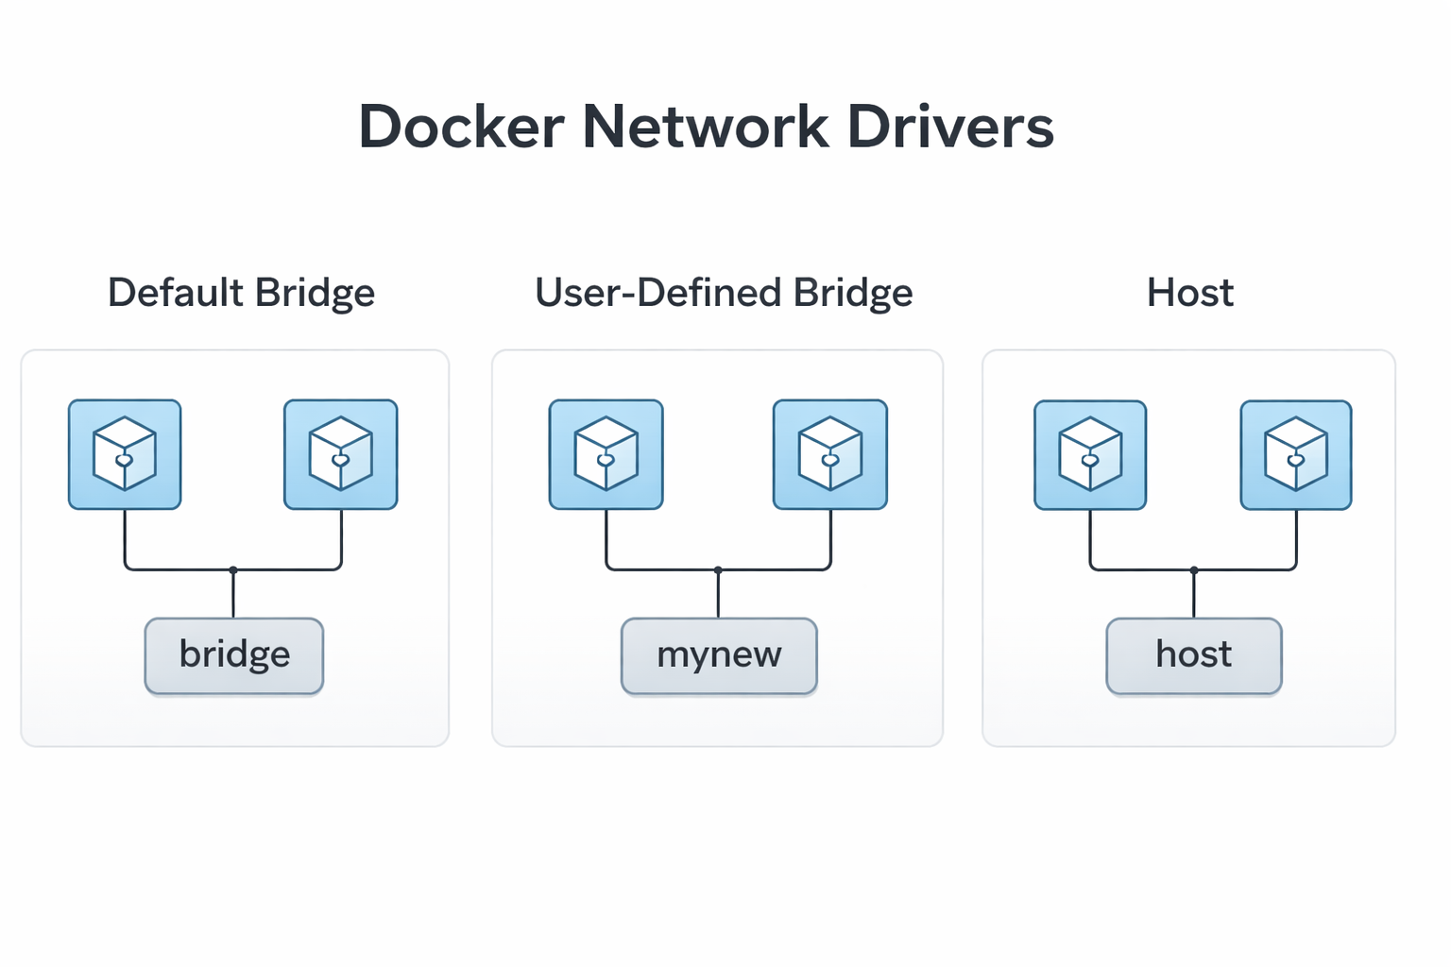

Slide 24
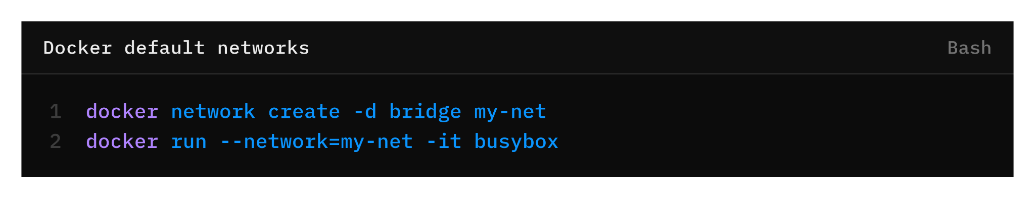
User-defined networks
You can create custom, user-defined networks, and connect groups of containers to the same network.
Once connected to a user-defined network, containers can communicate with each other using container IP addresses or container names.
You can connect existing container to network using docker network connect or using --network option on running container.

Slide 25
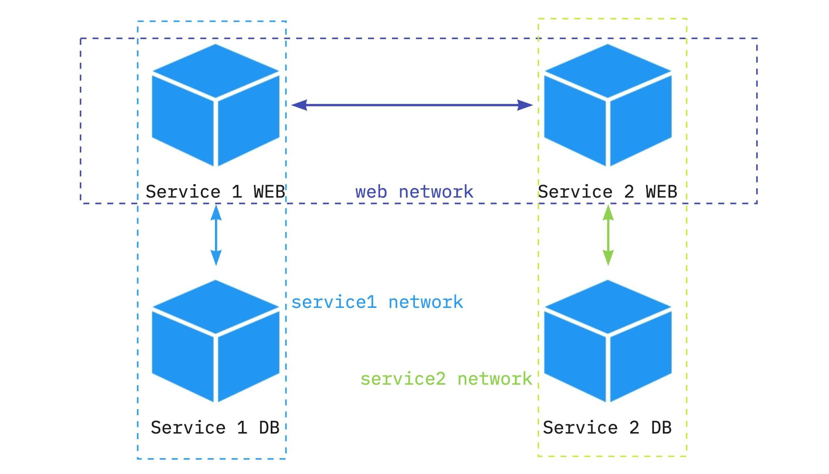

Slide 26
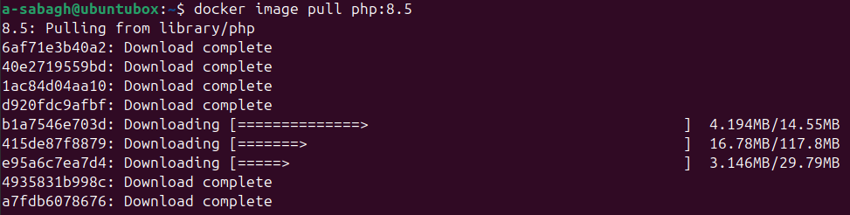
Image Layer stack
Container images are composed of layers.
Image Layers are immutable.

Slide 27
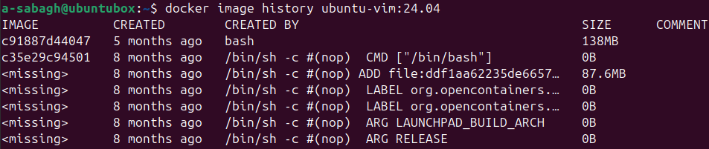
Image Layer history
Each layer in an image contains a set of filesystem changes - additions, deletions, or modifications.
After each layer is downloaded, it is extracted into its own directory on the host filesystem.
Docker stores image layers on the host at: /var/lib/docker/overlay2/

Slide 28
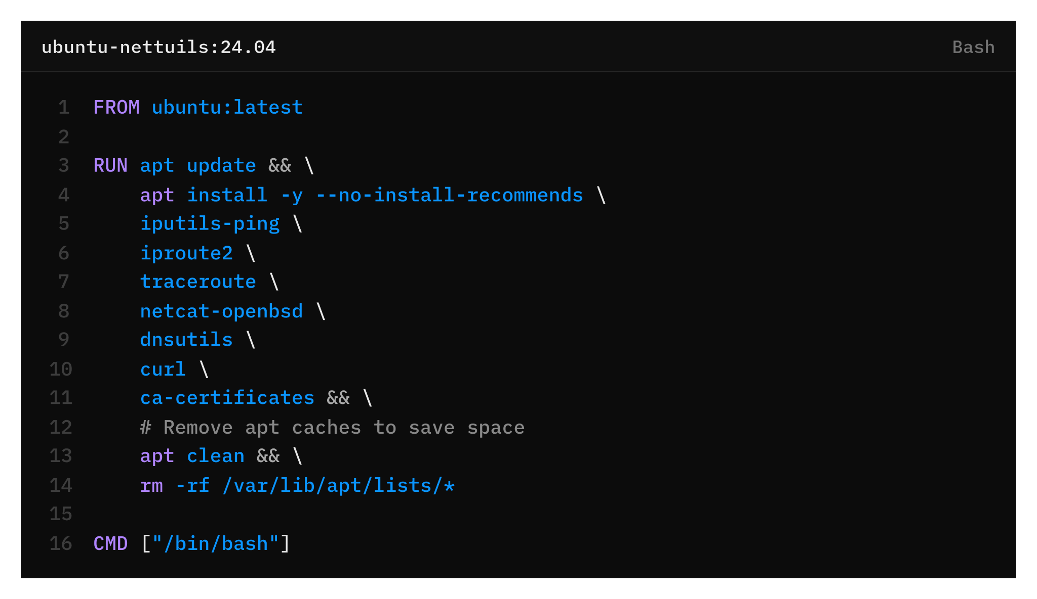
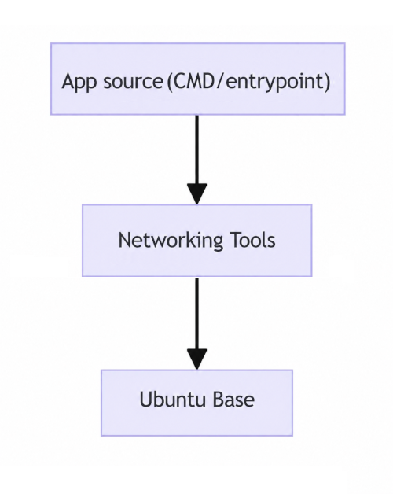

Slide 29


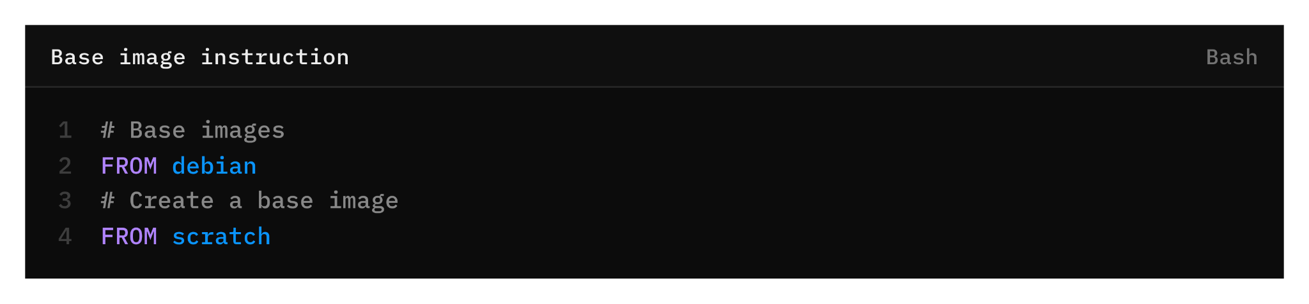
Base Image
All Dockerfiles start from a base image.
Your image extend base image.
Docker Hub contains a vast library of Docker images that are suitable as base image.
The scratch image is typically used to create minimal images.

Slide 30
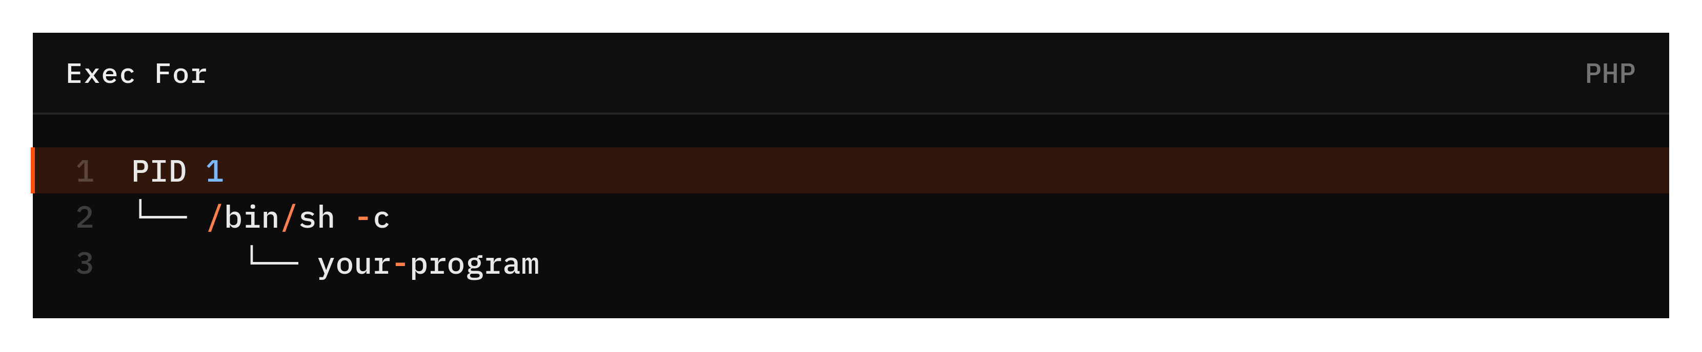
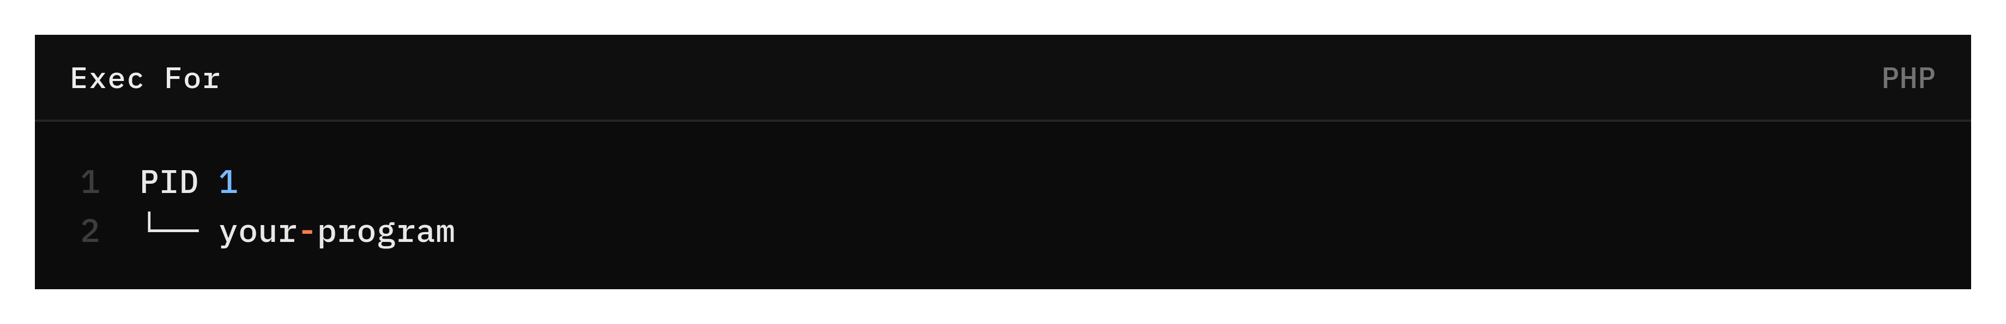
Exec / Shell Form tree
CMD, RUN, ENTRYPOINT as a subcommand of /bin/sh -c command becomes a child process of the shell.
CMD, RUN and ENTRYPOINT run directly.

Slide 31
ENTRYPOINT and CMD co-operations
ENTRYPOINT and CMD can be written in shell or exec form and can be used individually or together.
The shell form of ENTRYPOINT ignores any CMD or docker run command line arguments. It also starts your ENTRYPOINT as a subcommand of /bin/sh -c, which does not pass signals.
ENTRYPOINT and CMD only take effects when container is start __ wether via docker container run
ENTRYPOINT and CMD are ignored on docker exec command line.
The --entrypoint option be used to override ENTRYPOINT when running container.
Docker recommends defining ENTRYPOINT when container intended to behave like an executable.
Sometimes the application requires some preparation steps before starting its main process in the container.
The starter script can be named either of docker-entrypoint.sh, entrypoint.sh.
exec is build-in command in bash shell. Using exec “$@” it replaced current shell process with new command.

Slide 32
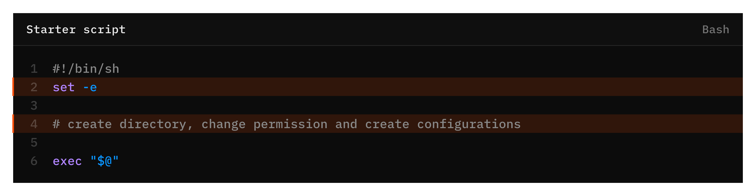
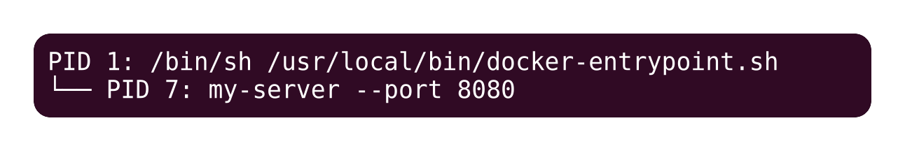
Direct ENTRYPOINT vs Starter script

Slide 33
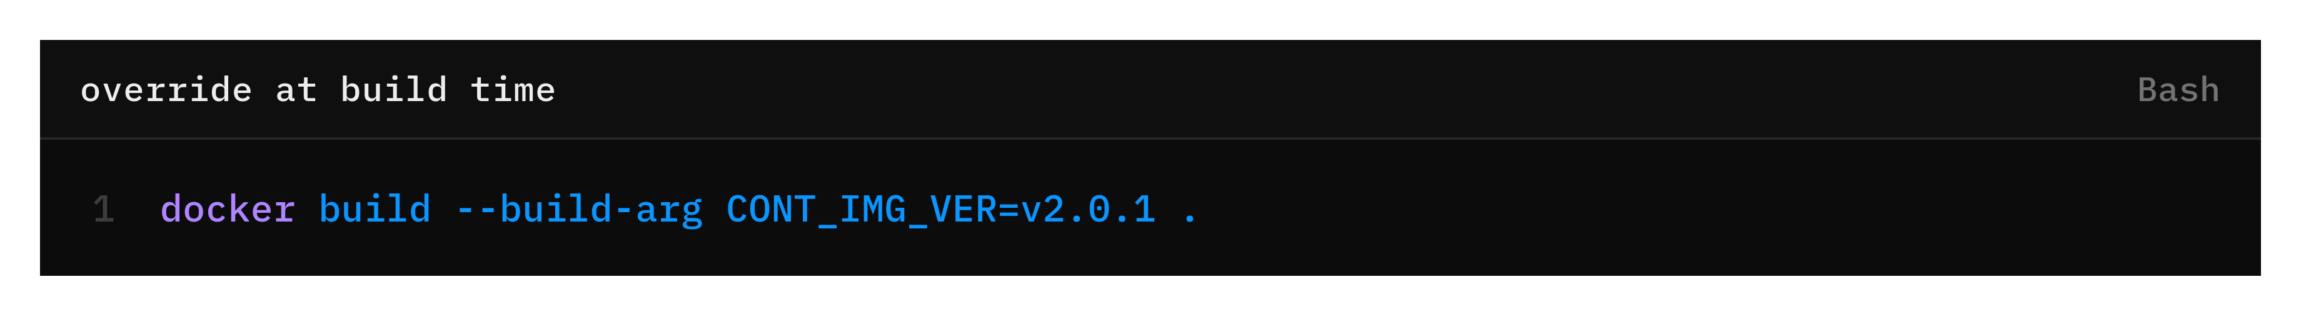
ARG INSTRUCTION
The ARG instruction __or build argument__ defines argument in the build process.
Users can provide its value when building image docker buildx build –build-arg varname=value
If an ARG instruction has default value and there is no value passed at build time, builder uses the default.
The default value of an ARG instruction remains as a fallback value in Dockerfile.
Reference this variable using $VAR or ${VAR} in FROM, ENV, WORKDIR, RUN and other Dockerfile instructions.
The ARG instruction only available during the image build and not available in the final container.
Build arguments are visible in docker image history command so that don’t pass secrets via ARG.
The scope of ARG variable is begins at the line where it is declared in Dockerfile.

Slide 34
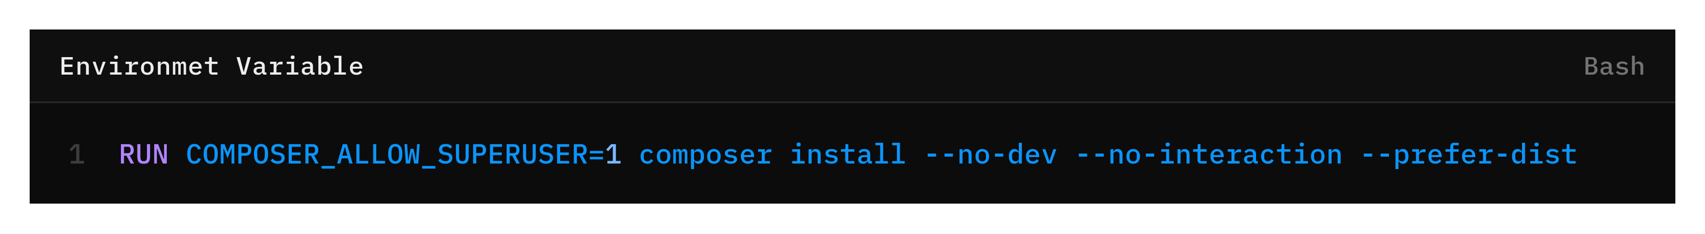
ENV INSTRUCTION
The ARG instruction is available only during the image build process. In the other hand the ENTRYPOINT script is executed when container start. Therefore the ARG is unavailable the the ENTRYPOINT script at runtime.
The appropriate solution is to use ENV instruction.
The environment variables set using ENV will persist when a container is run from the resulting final image.
The ENV instruction is commonly used as none-sensitive application configuration and default runtime settings.
You can view the values using docker inspect and change them using docker run --env <key>=<value>
You can assign the environment variable directly in the specific command instead of persisting it in the final image.

Slide 35
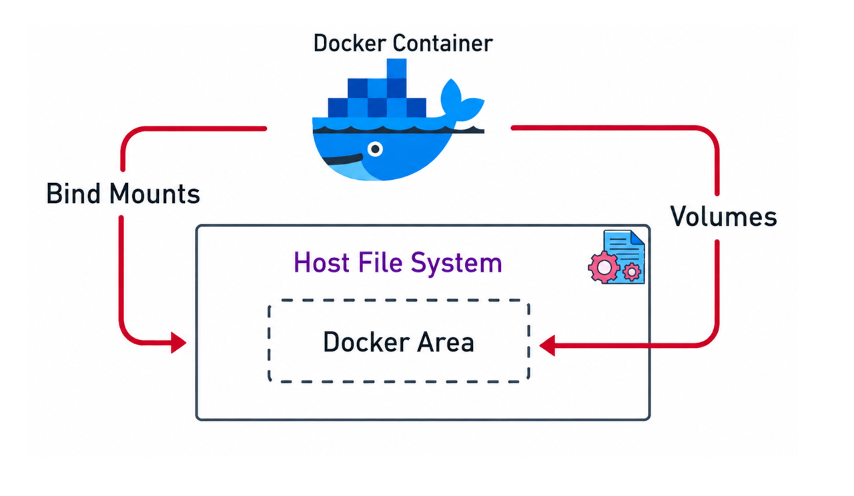

Slide 36
VOLUME INSTRUCTION
The Volume instruction creates a mount point directory and indicates that is intended to store data from outside the container such as host machine or other container.
Based on storage management Docker utilize tow main type of volumes: bind mount volumes and named volumes.
The bind mount volumes managed by the host OS and The named volumes managed by Docker Engine.
In this specific context Docker utilize the tow type of volumes: anonymous and named volumes.
The Dockerfile results an image causes docker run command to automatically create mount volume in the host machine even if you don’t provide --volume option while running the container.
If you don’t specify a volume name using the -v or --volume Docker automatically creates an anonymous volume.
You can specify the named volume using: docker run -v <volume-name>:<container-path>
You can specify the bind mount volume: docker run -v <absolute_host_path>:<container_path>
Multiple containers can share the same volume name.

Slide 37
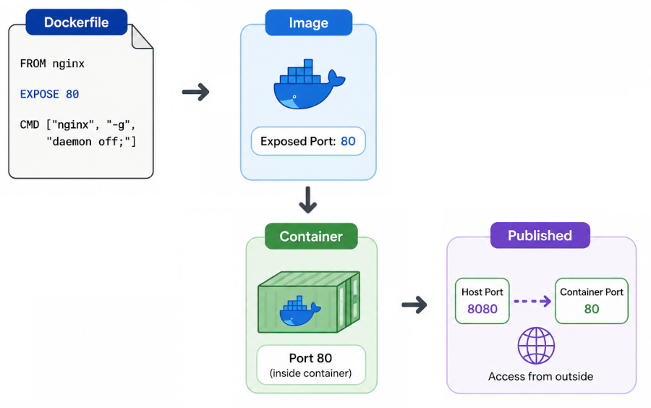

Slide 38
EXPOSE INSTRUCTION
The EXPOSE instruction informs the Docker that the container listens to the specified network port at runtime.
The EXPOSE instruction uses TCP as its default protocol, but you can change it to UDP if you wish.
The EXPOSE instruction doesn’t actually publish the port. It functions as a type of documentation between the person who write the image and the person who run the container about which port are intended to be published.
Previous slide is about showing transition from defining the network port in the image to publishing it in the container.
The EXPOSE declare a container port, while the -p or -P actually make the port accessible from the host.
-p, --publish list (Publish a container's port(s) to the host)
-P, --publish-all (Publish all exposed ports to high numbered random ports)
Use docker run -p {HOST_PORT}:{CONTAINER_PORT} to publish it.

Slide 39
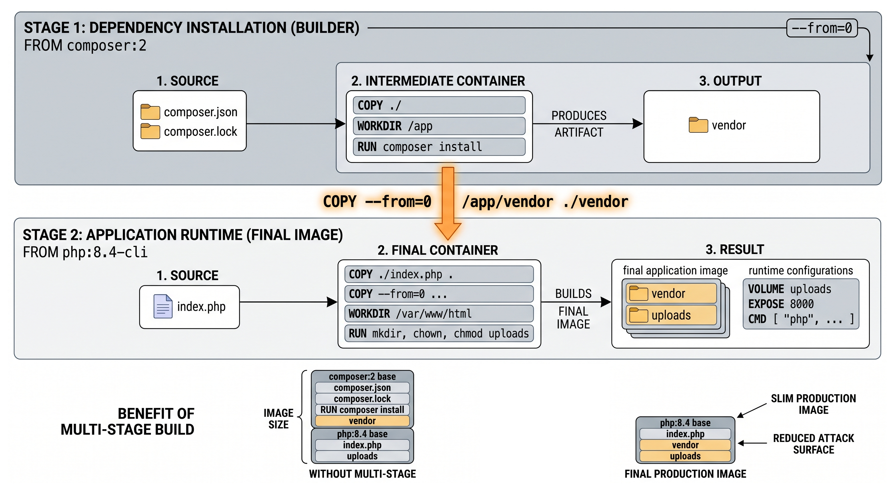

Slide 40
Multi-stage Build
With multi-stage build you can use multiple FROM statements in your Dockerfile.
You can copy the artifact __build directory, compiled binary file, etc__ from one stage to another, leaving behind everything you don’t want in the final image.
A Docker stage index is refers to the numeric position of build stage in a multi-stage Dockerfile.
Docker stage index starts at 0 for the first FROM instruction.
Docker stage name is a custom label you give to the specific stage in a Dockerfile using AS <name> at the end of FROM instruction.
For stages that have multiple syllables recommend lowercase kebab-case naming convention.
The ENV and ARG instructions are inherited trough stage ancestry__Not simple because a stage appear later in Dockerfile.
The --target flag lets you to set the target build stage from Dockerfile stages at docker buildx build CLI.

Slide 41
WORKDIR
The WORKDIR sets the working directory for any RUN, ENTRYPOINT, CMD, COPY and ADD instructions that follow it in Dockerfile.
If the WORKDIR doesn’t exist, it will be created even it isn’t used in any subsequent Dockerfile instruction.
The WORKDIR can be used multiple times in a Dockerfile, If the relative path is provided, it will be relative to the path of the previouse WORKDIR instruction.
If it is not specified and you are using scratch as a base image the working directory is / (root).
If you aren’t building a Dockerfile from scratch, the WORKDIR is likely set by the base image you are using. For example in the php:8.4-apache image the current working directory is /var/www/html
Therefore to avoid unintended operations in unknown directories, it is best practice to explicitly set the WORKDIR in your Dockerfile.

Slide 42


HEALTHCHECK
The HEALTHCHECK instruction tells Docker how to test container to make sure container works properly.
This can detect any defect such as a web server stuck in an infinitive loop and unable to handle a connection even though a web server process is still running.
Container life cycle status: Indicate the state of the container process (PID) such as running, stopped or paused.
Health status: Wether the application inside a running container is actually functioning correctly.
Whenever the health check passes, the container is marked as healthy regardless of its previous state. After a certain number of consecutive failure it becomes unhealthy.
HEALTHCHECK [OPTIONS] CMD command (check container health by running a command inside the container)
Docker treats exit code 0 as healthy state and exit code 1 as unhealthy state.

Slide 43
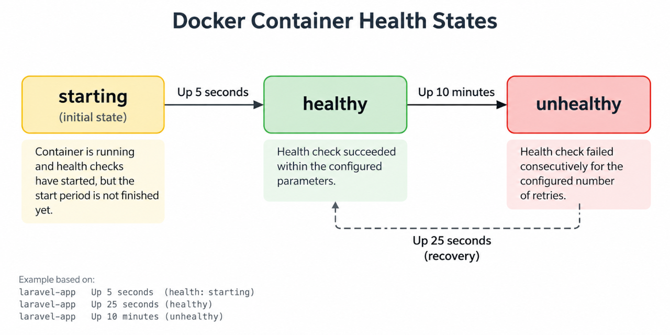

Slide 44
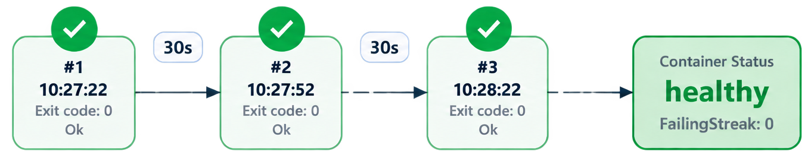
HEALTHCHECK inspection
Using docker inspect -f ‘{{json .Config.Healthcheck }}’ command you can inspect the configured HEALTHCHECK command of a container.
Using docker inspect -f ‘{{json .State.Health }}’ , you can inspect the health state of a container.

Slide 45
HEALTHCHECK options
--interval=DURATION Defines how often Docker runs the healthcheck command. By default every 30 seconds Docker runs the healthcheck command.
--timeout=DURATION Defines how long Docker waits for the healthcheck command to finish. By default Docker waits 30 seconds for the healthcheck command to finish.
--start-period=DURATION Defines a startup grace period where the failed checks are ignored. The health monitoring begins once the start period is finished. Without this option Docker might mark the container unhealthy while it is still running. Successful checks are counted and failed checks are ignored during the start period.
--start-interval=DURATION Controls the frequency of checks during the start period.
--retries=N Define how many consecutive failures are required before the Docker marks the container as unhealthy.

Slide 46
Build Context
Dockerfile contains instructions while the build context provide the files and resources that those instructions can reference when needed, such as COPY instruction which can copy files from specified build context. In another words the build context is sets of files Docker can access while building the image (executing Dockerfile).
We can use several types of build context when building an image. The most common ones are Local and Git build contexts.
To use a Local build context you can specify a relative or absolute path as an argument to the docker buildx build
When you pass a URL pointing to the location of a Git repository as an argument of the docker buildx build, the builder uses the repository as the build context.

